Slide 1
SEPM NUMERICALS (UNIT 1, 2, 3)
RAVI PRAKASH SHAHI
8979048096
rprakash@ddn.upes.ac.in

Slide 2
FUNCTION POINT ANALYSIS (FPs)
The principle of Albrecht’s function point analysis (FPA) is that a system is decomposed into functional units.
Inputs (EI): information entering the system
Outputs (EO) : information leaving the system
Enquiries (EQ): requests for instant access to information
Internal logical files (ILF) : information held within the system
External interface files(EIF) : information held by other system that is used by the system being analyzed.

Slide 3
Special features of Function Points
Function point approach is independent of the language, tools, or methodologies used for implementation; i.e. they do not take into consideration programming languages, data base management systems, processing hardware or any other data base technology.
Function points can be estimated from requirement specification or design specification, thus making it possible to estimate development efforts in early phases of development.
Function points are directly linked to the statement of requirements; any change of requirements can easily be followed by a re-estimate.
Function points are based on the system user’s external view of the system, non-technical users of the software system have a better understanding of what function points are measuring

Slide 4
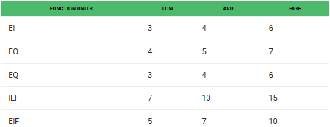
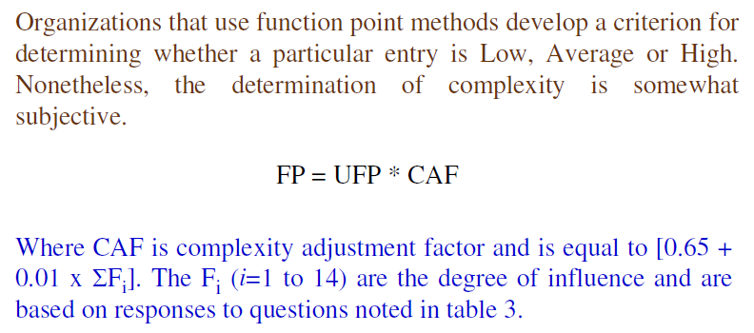
Calculation of Unadjusted Function Points

Slide 5
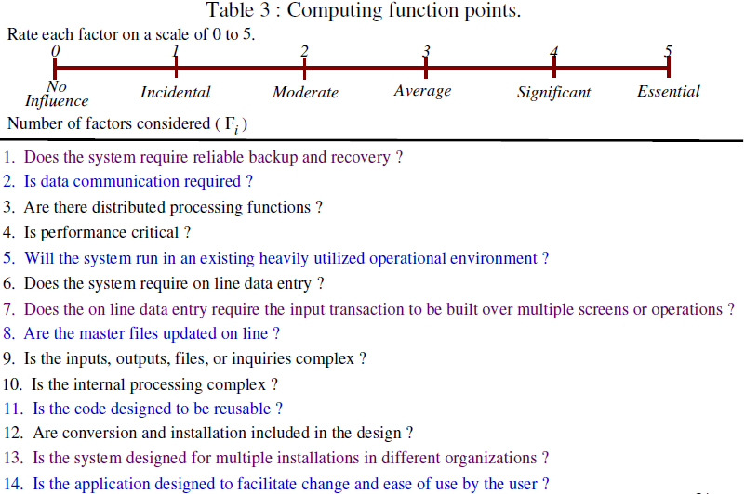

Slide 6
Example 1
Consider a project with the following functional units:
Number of user inputs = 50
Number of user outputs = 40
Number of user enquiries = 35
Number of user files = 06
Number of external interfaces = 04
Assume all complexity adjustment factors and weighting factors are average.
Compute the unadjusted and adjusted function points for this project.

Slide 7
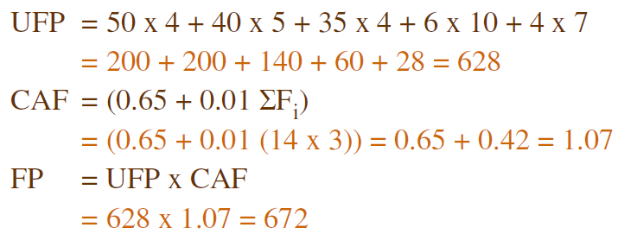

Slide 8
Example 2
An application has the following:
10 low external inputs, 12 high external outputs, 20 low internal logical files, 15 high external interface files, 12 average external inquiries, and a value of complexity adjustment factor of 1.10.
What are the unadjusted and adjusted function point counts ?

Slide 9
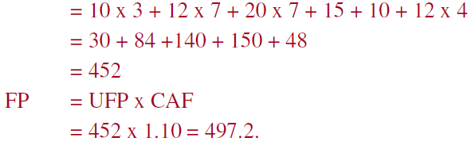
SOLUTION :
Unadjusted function points (UFP) is calculated as:
= 497

Slide 10
Example 3
Consider a project with the following parameters.
1. External Inputs: 10, 15 and 17 with L, A and H complexity respectively
2. External Outputs: 6 and 13 with low and high complexity respectively
3. External Inquiries: 3, 4 , 2 with L, A and H complexity respectively
4. Internal logical files: 2 and 1 with average & high complexity respectively
5. External Interface files: 9 with low complexity
In addition to above, system requires
i. Significant data communication
ii. Performance is very critical
iii. Designed code may be moderately reusable
iv. System is not designed for multiple installation in different
organizations.
Other complexity adjustment factors are treated as average.
Compute the unadjusted and adjusted FPs for the project.

Slide 11
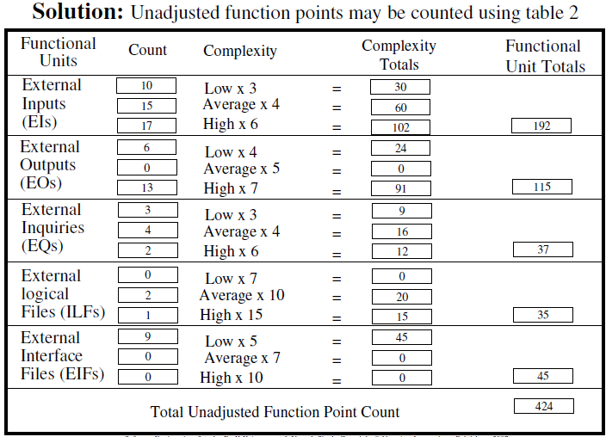

Slide 12
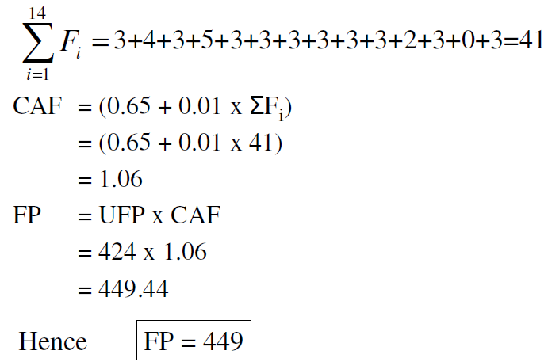

Slide 13
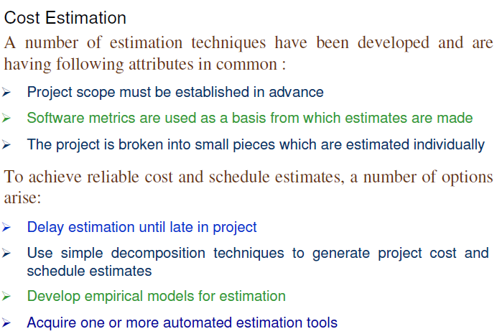

Slide 14
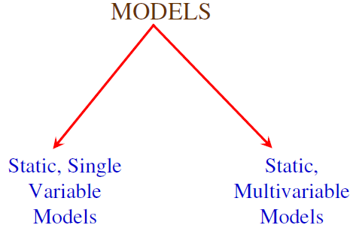
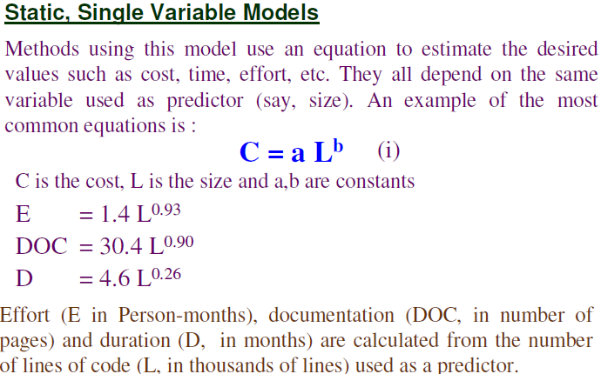

Slide 15
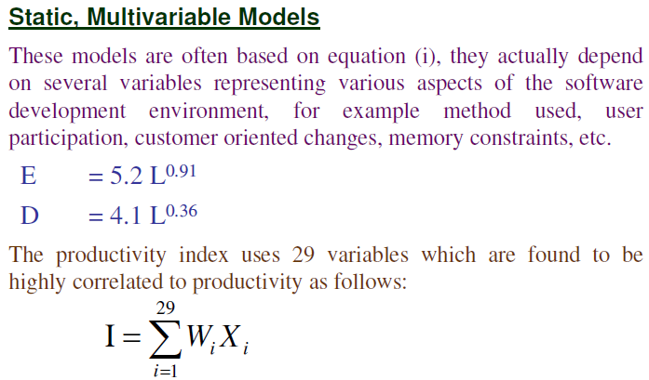
W-F COST MODEL

Slide 16
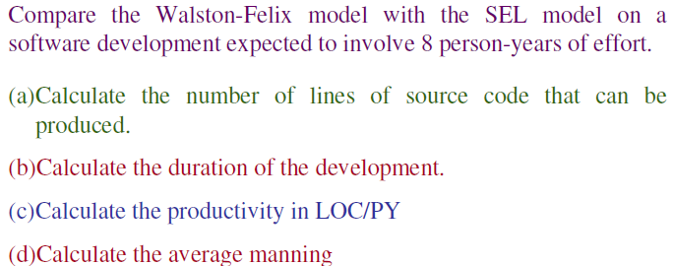
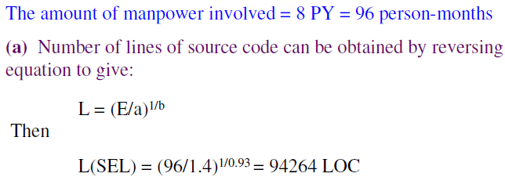
Example 4
SOLUTION :
L (W-F) = (96/5.2)1/0.91 = 24.632 KLOC = 24632 LOC

Slide 17
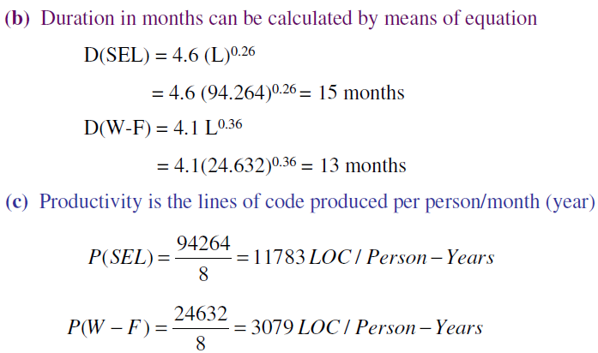
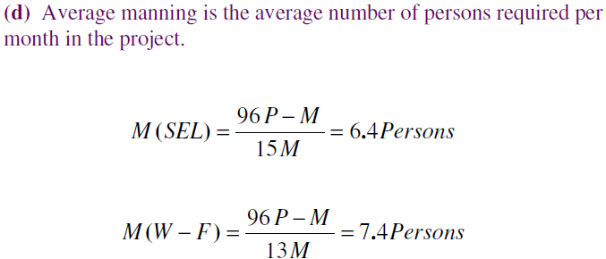

Slide 18
COCOMO COST MODEL TECHNIQUES

Slide 19
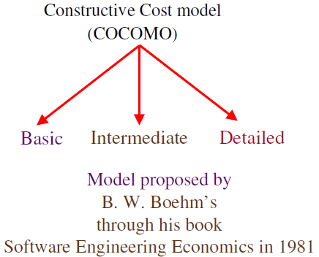
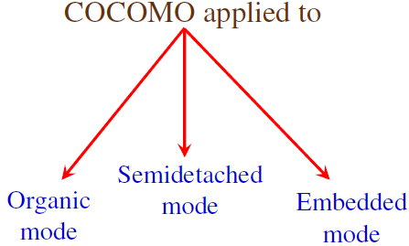

Slide 20
Cocomo (Constructive Cost Model) is a regression model based on LOC, i.e number of Lines of Code. It is a procedural cost estimate model for software projects and often used as a process of reliably predicting the various parameters associated with making a project such as size, effort, cost, time and quality. It was proposed by Barry Boehm in 1970 and is based on the study of 63 projects, which make it one of the best-documented models.
The key parameters which define the quality of any software products, which are also an outcome of the Cocomo are primarily Effort & Schedule:
Effort: Amount of labor that will be required to complete a task. It is measured in person-months units.
Schedule: Simply means the amount of time required for the completion of the job, which is, of course, proportional to the effort put. It is measured in the units of time such as weeks, months.

Slide 21
Types of Projects (to which COCOMO Model is applied)
Boehm’s definition of organic, semidetached, and embedded systems:
Organic – A software project is said to be an organic type if the team size required is adequately small, the problem is well understood and has been solved in the past and also the team members have a nominal experience regarding the problem.
Semi-detached – A software project is said to be a Semi-detached type if the vital characteristics such as team-size, experience, knowledge of the various programming environment lie in between that of organic and Embedded. The projects classified as Semi-Detached are comparatively less familiar and difficult to develop compared to the organic ones and require more experience and better guidance and creativity. Eg: Compilers or different Embedded Systems can be considered of Semi-Detached type.
Embedded – A software project with requiring the highest level of complexity, creativity, and experience requirement fall under this category. Such software requires a larger team size than the other two models and also the developers need to be sufficiently experienced and creative to develop such complex models.

Slide 22
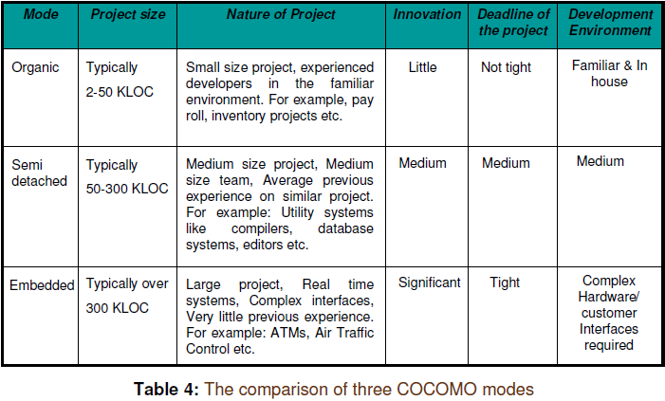

Slide 23
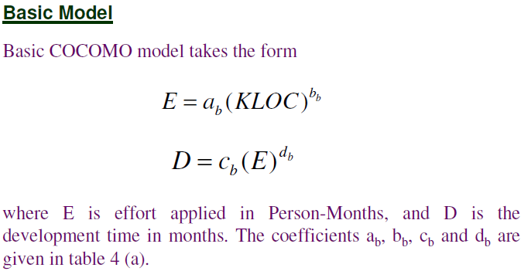
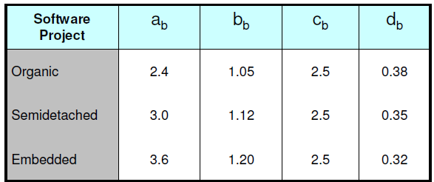

Slide 24
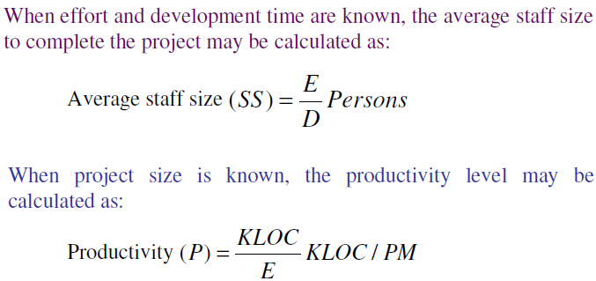

Slide 25
Example 5
Suppose that a project was estimated to be 400 KLOC.
Calculate the effort and development time for each of the three modes i.e., organic, semidetached and embedded.

Slide 26
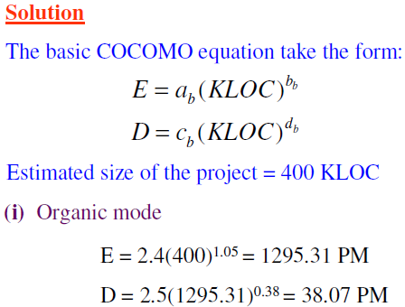
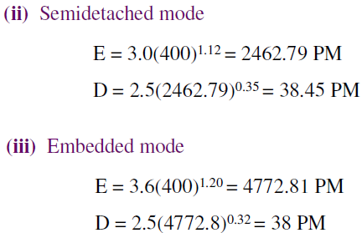

Slide 27
Example 6
A project size of 200 KLOC is to be developed. Software development team has average experience on similar type of projects. The project schedule is not very tight.
Calculate the effort, development time, average staff size and productivity of the project.

Slide 28
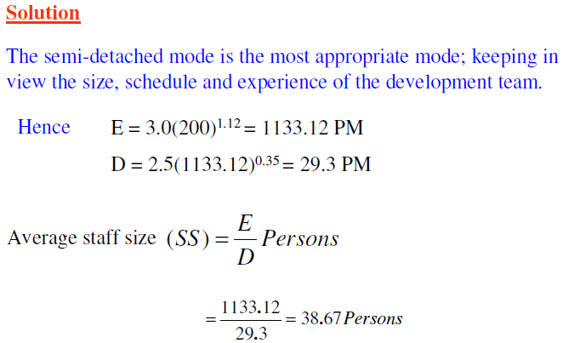

Slide 29
MODEL 2 - INTERMEDIATE COCOCMO MODEL

Slide 30
Intermediate COCOMO
The basic Cocomo model assumes that the effort is only a function of the number of lines of code and some constants evaluated according to the different software system.
However, in reality, no system’s effort and schedule can be solely calculated on the basis of Lines of Code. For that, various other factors such as reliability, experience, Capability.
These factors are known as Cost Drivers and the Intermediate Model utilizes 15 such drivers for cost estimation.
The Intermediate COCOMO model computes software development effort as a function of program size and a set of "cost drivers" that include subjective assessments of product, hardware, personnel and project attributes.
Each of the 15 attributes is rated on a 6 point scale that ranges from "very low" to "extra high" (in importance or value). Based on the rating, an effort multiplier is determined from tables published by Boehm [BOE81], and the product of all effort multipliers results is an effort adjustment factor (EAF). Typical values for EAF range from 0.9 to 1.4.

Slide 31
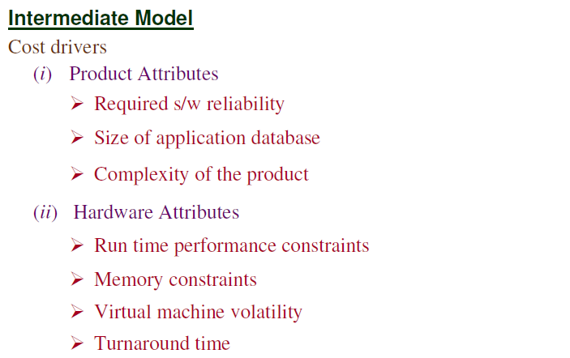

Slide 32
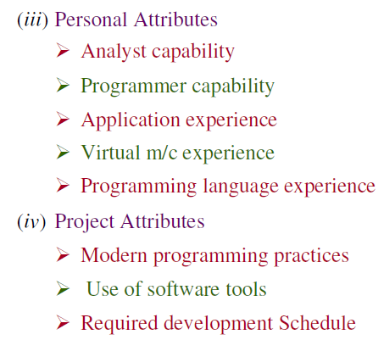

Slide 33
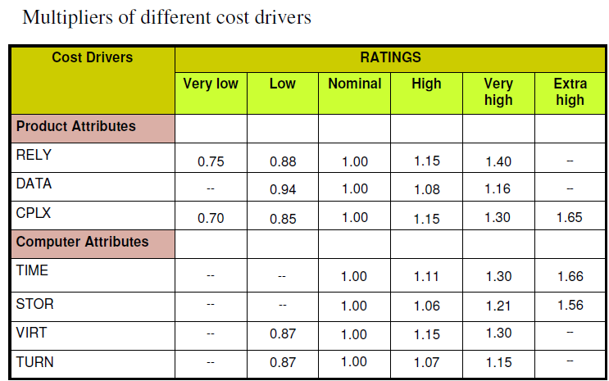

Slide 34
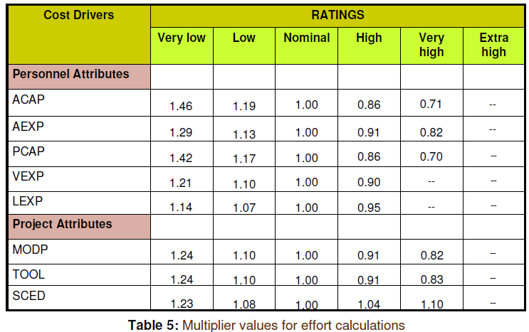

Slide 35
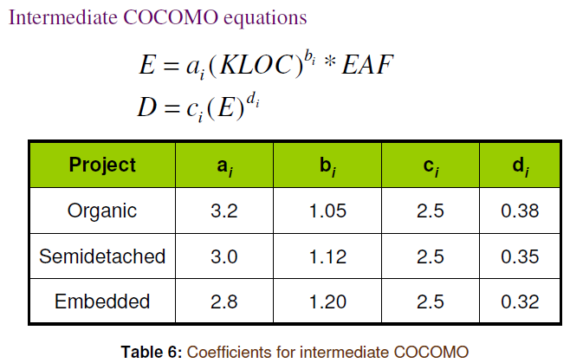

Slide 36
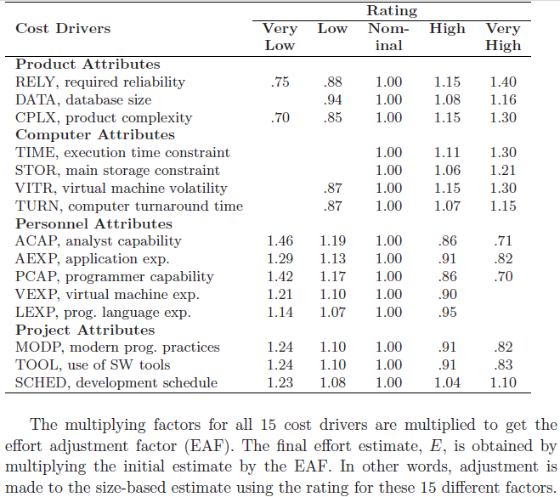
Table 1: Effort multipliers for different cost drivers

Slide 37
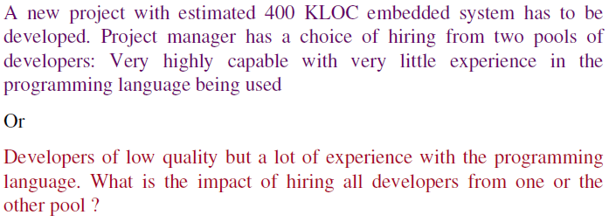
Example 7

Slide 38
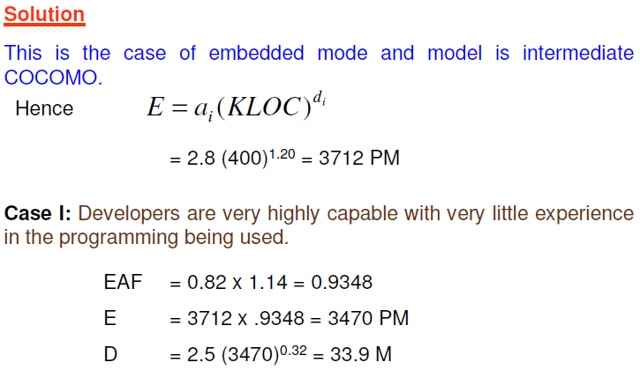

Slide 39
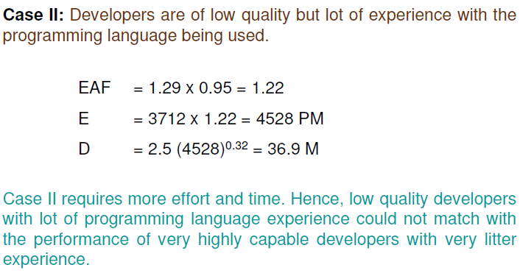

Slide 40
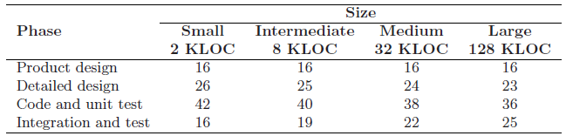
Table 2: Phasewise distribution of effort
Table 3: Phasewise distribution of schedule
Phase | Small 2 KLOC | Intermediate 8 KLOC | Medium 32 KLOC | Large 128 KLOC
Product /System design | 19 | 19 | 19 | 19
Detailed design | 24 | 23 | 21 | 19
Module Code & Unit Test | 39 | 36 | 34 | 32
Integration & Test | 18 | 22 | 26 | 30

Slide 41
Example 8
Consider a system being built for supporting auctions in a university. From the SRS documented by the Experienced Analysts, it was decided that the system will comprise of these modules :
Login 200 LOC
Payment 200 LOC
Administrator interface 600 LOC
Seller functions 200 LOC
Buyer functions 500 LOC
View and bookkeeping 300 LOC
Suppose we expect that the complexity of the system is high, the programmer capability is low, and the application experience of the team is low. All other factors have a nominal rating.
Compute the effort and duration of the project.
Also estimate the effort for each of the different phases of development.

Slide 42
Solution
The total size of this software is estimated to be 2 KLOC.
Effort adjustment factor (EAF) is
EAF = 1.15 * 1.17 * 1.13 = 1.52
The initial effort estimate for the project is obtained as
E _{i} = 3.2 * (2.0) ^{1.05} = 6.63 PM
Using the EAF, the adjusted effort estimate is
E = 1.52 * 6.63 = 10.08 PM.
From the overall estimate, estimates of the effort required for the different
phases in the projects can also be determined. This is computed as follows :
System Design = 0.16 x 10.08 = 1.613 PM
Detailed Design = 0.26 x 10.08 = 2.621 PM
Module Code & Test = 0.42 x 10.08 = 4.233 PM
Integration & Test = 0.16 x 10.08 = 1.613 PM

Slide 43
COST-BENEFIT EVALUATION TECHNIQUES
PROF. RAVI PRAKASH SHAHI
8979048096
rprakash@ddn.upes.ac.in

Slide 44
1. NET PROFIT
The Net Profit of a project is the difference between the total income (revenue) and the total costs over the life of the project
Remark :
Cashflows take place at the end of each year. The year 0 represents the initial investment made at the start of the project.
Project 2 shows the greatest Net Profit but this is at the expense of a large investment.
Moreover, the simple net profit takes no account of the timing of Cashflows.

Slide 45
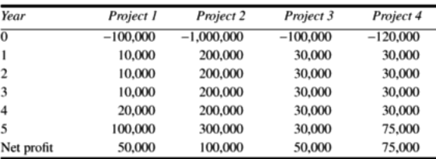
Table 1:

Slide 46
2. PAYBACK PERIOD
The time taken to break even or pay back the total initial investment.
Normally, the project with the shortest payback period will be chosesn as the best/optimal project on the basis of NPV.
Payback period for Project 1 = time taken to pay back the initial investment
= 5 - (50,000 / 100,000) = 4 ½ years = 4 years 6 months
Payback period for Project 3 = time taken to pay back the initial investment
= 4 - (20000 / 30000) = 3.33 years = 3 years 4 months
Remark :
Advantage of Payback period is that it is simple to calculate and is not particularly sensitive to small forecasting errors.
Its disadvantage is that it ignores the overall profitability of the Project. This the fact that Projects 2 and 4 are, overall more profitable then Project 3 is ignored

Slide 47
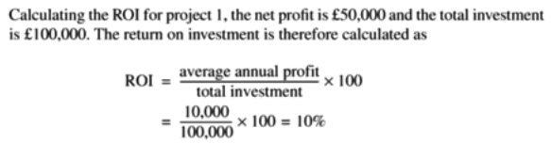
3. RETURN ON INVESTEMENT (ROI)/ARR
The ROI also known as Accounting Rate of Return (ARR) provides a way of comparing the Net Profitability to the Total investment required.
Normally, the project with the maximum ROI is chosen as the optimal project
For Project 2 :
Average Annual Profit = Net Profit ÷ Project duration = 100,000 / 5 = 20,000
ARR = (average annual profit / total investment) * 100 = (20,000/1000,000) * 100 = 2%

Slide 48
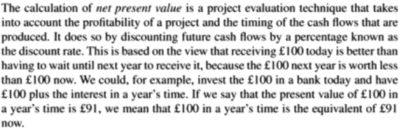
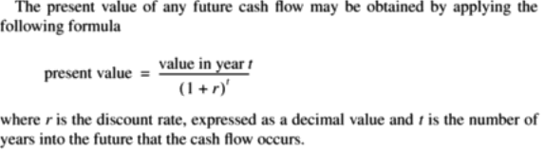
4. NET PRESENT VALUE (NPV)

Slide 49
COMPUTATION OF NPV for Project 4
Year | Cash flow | Discount factor @10% | Discounted cash flow
0 | -120K | 1.0000 | -120 K
1 | 30 K | 0.9091 | 27.273 K
2 | 30 K | 0.8264 | 24.792 K
3 | 30 K | 0.7513 | 22.539 K
4 | 30 K | 0.6830 | 20.490 K
5 | 75 k | 0.6209 | 46.568 K
Net Profit : | 75,0000 | NPV : | 21,662

Slide 50
Example 2
A company projecting revenue of 40 lacs in first year and the revenue is going to increase @10 lacs every year for the next 3 years in succession, after which revenue decreases by 15 lacs in the fifth year and thus will be closed after 5 years.
The fixed initial investment for the project is 150 lacs and working capital requirement is 30 lacs.
Compute these for the project :
Payback Period
ROI
NPV assuming 12.5% discount rate

Slide 51
SOLUTION
Payback period
= time taken to pay back the total investment of 180 Lac
= 4 - (40/70) years = 3.43 years = 3 years 5 months 4 days
Average Annual Profit = Net Profit ÷ Project duration
= 95 lacs ÷ 5 = 19 lacs.
Hence, the ROI = (average annual profit / total investment ) * 100
= (19/180) * 100 = 10.55 %
Calculation of NPV :
Year | Cash flow | Discount factor @12.5% | Discounted cash flow | Cumulative Profit/revenue
0 | -180 L | 1.0000 | -180 L | -180 L
1 | 40 L | 0.8889 | 35.556 L | -140 L
2 | 50 L | 0.7901 | 39.505 L | -90 L
3 | 60 L | 0.7023 | 42.138 L | -30 L
4 | 70 L | 0.6243 | 43.701 L | 40 L
5 | 55 L | 0.5549 | 30.5195 L
Net Profit : | RS 95 Lacs | NPV : | 11.4195 L = Rs 11,41,950

Slide 52
SEPM MCQS (FOR PRACTICE)
RAVI PRAKASH SHAHI
8979048096
rprakash@ddn.upes.ac.in

Slide 53
Question 1
Which is not a step of requirement engineering?
Requirements elicitation
Requirements analysis
Requirements documentation
Requirements design

Slide 54
Question 2
SRS document is for
“what” of a system
How to design the system?
Costing and scheduling of a system
System’s requirement

Slide 55
Question 3
In which step of SDLC project termination could be done?
Design
Maintenance
Feasibility Study
Coding

Slide 56
Question 4
Which one is not a type of requirement?
unknown requirements
known requirements
Complex requirements
Undreamt requirements

Slide 57
Question 5
Which is not a characteristic of a good SRS?
a) correct
b) complete
c) consistent
d) brief

Slide 58
Question 6
Which of the following is the understanding of software product limitations, learning system related problems or changes to be done in existing systems beforehand, identifying and addressing the impact of project on organization and personnel etc?
Software Design
Feasibility Study
Requirements Gathering
System Analysis

Slide 59
Question 7
Which is not a non-functional requirement ?
Efficiency
Reliability
Product features
Stability

Slide 60
Question 8
Which of the following is not defined in a good Software Requirement Specification (SRS) document?
Functional requirement
NFR
Goals of implementation
Algorithm for software implementation Project

Slide 61
Question 9
In _________________ phase you will build the physical project deliverables and present them to your customer for signoff
Initiation
Planning
Execution
Termination

Slide 62
Question 10
Use case approach was developed by
J.D. Musa and others
I. Jacobson and others
B. Littlewood
None of these

Slide 63
Question 11
The major shortcoming of waterfall model is?
the difficulty in accommodating changes after requirement analysis.
the difficult in accommodating changes after feasibility analysis.
the system testing
Maintenance of the system

Slide 64
Question 12
The quick design of a software that is visible to end users leads to ............ model

Slide 65
Question 13
A system being developed has the following characteristics: Number of user inputs 10 (simple) Number of user outputs 7 (simple) Number of user inquiries 3 (average) Number of files 6 (average) Number of external interfaces 1 (complex) The function point(UFP) count for the system is:
a)140 b) 131 c)158 d)127

Slide 66
Question 14
Suppose a system requires i. Significant data communication ii. Performance is very critical iii.Designed code may be moderately reusable iv. System is not designed for multiple installation in different organizations. Other complexity adjustment factors are treated as average. Compute the CAF for the project. a) 1.12 b)1.06 c) 1.08 d) 1.09

Slide 67
Question 15
FAST stands for
Functional Application Specification Technique
Fast Application Specification Technique
Facilitated Application Specification Technique
None of these

Slide 68
Question 16
Which of these is a phase in the RAD Model?
Cut over phase
Testing
Coding
System Maintenance

Slide 69
Question 17
The max. % of errors is in the _________ phase
specifications
Coding
Design
Maintenance

Slide 70
Question 18
If user participation is available ______ model is to be chosen?
Waterfall
Iterative
Spiral
RAD

Slide 71
Consider the following Statement: “The data set will contain an end of file character.” What characteristic of SRS is being depicted here ?
Question 19
Consistent b) Non-verifiable c) Correct d) Ambiguous

Slide 72
Question 20
Consider the following Statement: “The output of a program shall be given within 10secs of event X 10% of the time.” What characteristic of SRS is being depicted here ?
Consistent b)Verifiable
c)Non-verifiable d) Correct

Slide 73
Question 21
A company projecting revenue of 64 lacs in first year and the revenue is going to increase by 25% every year for the next 3 years in succession, after which revenue decreases by 20 lacs in the fifth year and thus will be closed after 5 years. The fixed initial investment for the project is 120 lacs and the working capital requirement is 60 lacs.
Compute the Payback Period

Slide 74
Question 22
A company projecting revenue of 64 lacs in first year and the revenue is going to increase by 25% every year for the next 3 years in succession, after which revenue decreases by 20 lacs in the fifth year and thus will be closed after 5 years. The fixed initial investment for the project is 120 lacs and the working capital requirement is 60 lacs.
Compute the ROI

Slide 75
Question 23
A company projecting revenue of 64 lacs in first year and the revenue is going to increase by 25% every year for the next 3 years in succession, after which revenue decreases by 20 lacs in the fifth year and thus will be closed after 5 years. The fixed initial investment for the project is 120 lacs and the working capital requirement is 60 lacs.
Compute the NPV assuming 12.5% discount rate

Slide 76
Question 24
A company projecting revenue of 64 lacs in first year and the revenue is going to increase by 25% every year for the next 3 years in succession, after which revenue decreases by 20 lacs in the fifth year and thus will be closed after 5 years. The fixed initial investment for the project is 120 lacs and the working capital requirement is 60 lacs.
Compute the NPV assuming 20% discount rate

Slide 77
Question 25
A company projecting revenue of 64 lacs in first year and the revenue is going to increase by 25% every year for the next 3 years in succession, after which revenue decreases by 20 lacs in the fifth year and thus will be closed after 5 years. The fixed initial investment for the project is 120 lacs and the working capital requirement is 60 lacs.
Compute discount rate for which NPV is nearly zero

Slide 78
Solutions to Test 1
Q | Ans. |  | Q. | Ans.
1 | D |  | 14 | B
2 | A |  | 15 | C
3 | C |  | 16 | A
4 | C |  | 17 | A
5 | D |  | 18 | D
6 | B |  | 19 | C
7 | C |  | 20 | B
8 | D |  | 21 | 2 years 4 months 10 days
9 | C |  | 22 | 32.67%
10 | B |  | 23 | 146.63 Lacs
11 | A |  | 24 | 89.214 Lacs
12 | PROTOTYPING MODEL |  | 25 | 38.5%
13 | A

